Slide 1

Optically active Single Walled Carbon Nanotubes as FET sensors toward amino acids
Kranthi K.R. Bannuru
Group Leader: Prof. Dr. Andreas Herrmann
Polymer Chemistry and Bio-engineering Group
26 April, 2012

Slide 2
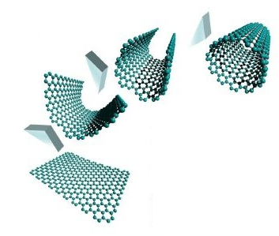
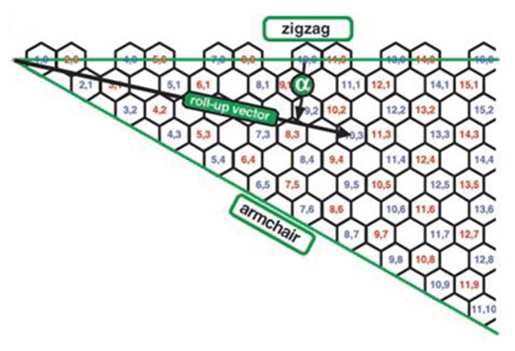
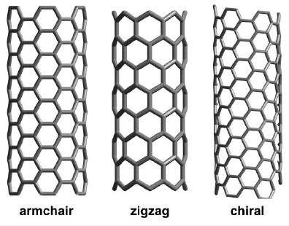
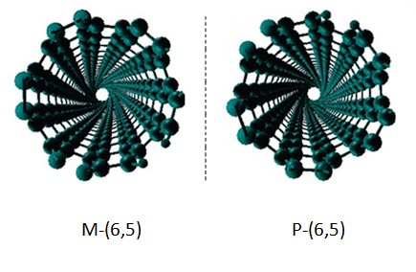
Optically active Single Walled Carbon Nanotube (SWNT)

Slide 3
Why to Separate?
As grown CNT have widely distributed chiral indices &diameters
Structure dependent physical properties (Optical, Electrical, Mechanical)
Bulk availability of uniform material- vital for technological applications
Chiral SWNT applications
asymmetric catalysis
Chiral molecule Sensing
Chiral resolution of racemates

Slide 4
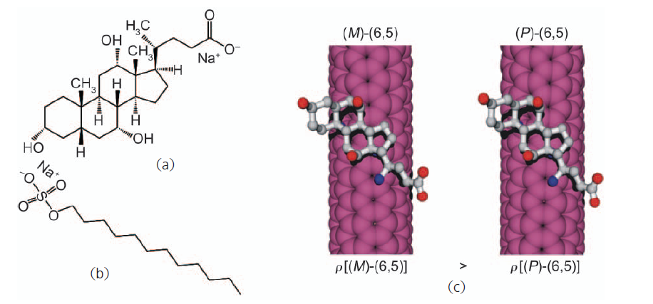
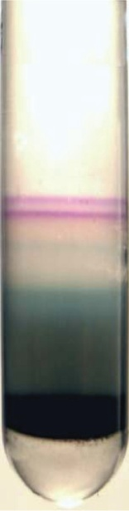
Density Gradient Ultracentrifugation
To separate components with differing buoyant densities
Liquid mixtures added to centrifuge to form a spatially varying density profile.
Under strong centrifugation, sample components migrate to regions matching their individual densities.
Ultracentrifugation
Green A. A. et al. Nano Res 2009, 2, 69.
Ghosh S. et al. nat. Nanotechnol. 2010, 5, 443.

Slide 5
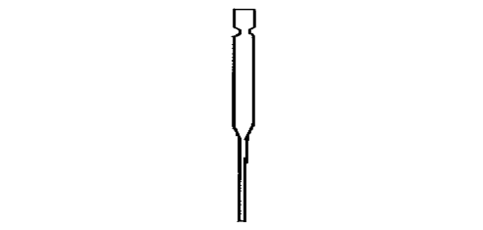
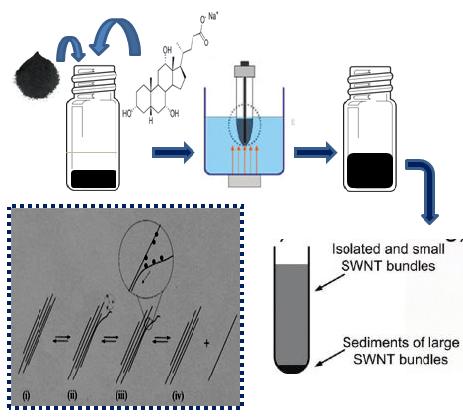
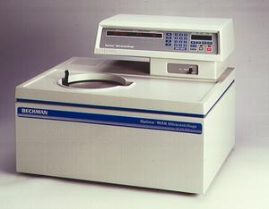
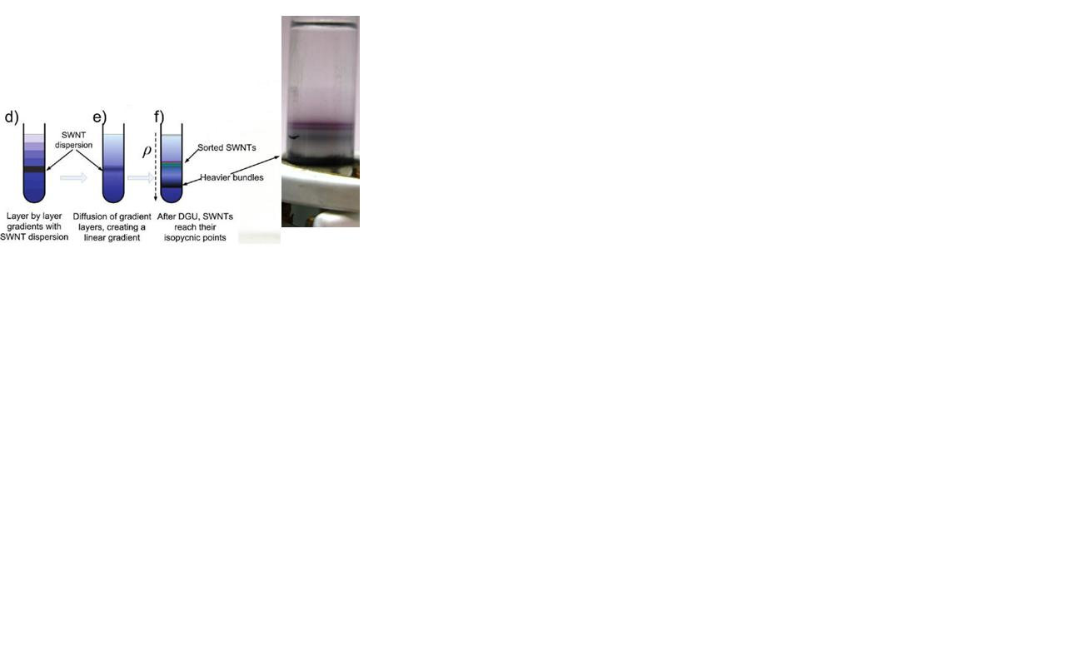
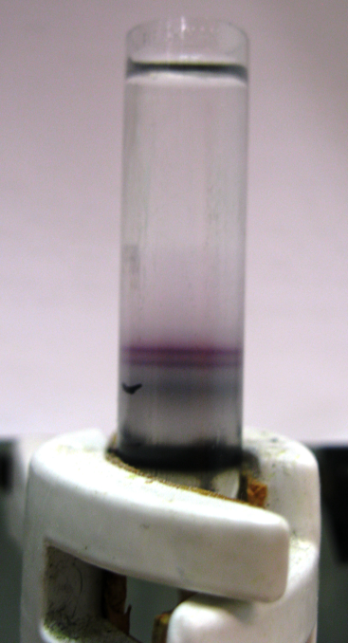
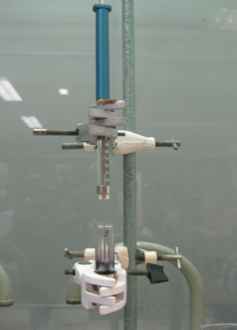
DGU technique for (6,5) SWNT sorting
1
2
Notes:
3 mnt

Slide 6
Tailoring the DGU Technique
Parameter | Literature | Tailored
Conc. Of Sodium Cholate in CNT dispersion | 2 % | 5 %
Tip Sonication time | 30 min | 2 h
Conc. of Sodium Cholate in the non-linear gradient | 0.7 % | 0.9 %
Conc. Of SDS in the non-linear gradient | 0.175 % | 0.225 %
Conc. of CNT dispersion loaded into the non-linear gradient | None | ½ (diluted with 2 % SC to obtain –(6,5) SWNT
Conc. of CNT dispersion loaded into the non-linear gradient | None | None (to obtain +(6,5) SWNT)

Slide 7
OPTICAL CHARACTERIZATION of SORTED SWNT
Absorption spectra of (6,5) SWNT
The specific absorbance of (6,5) SWNT are at 570 nm and 984 nm

Slide 8
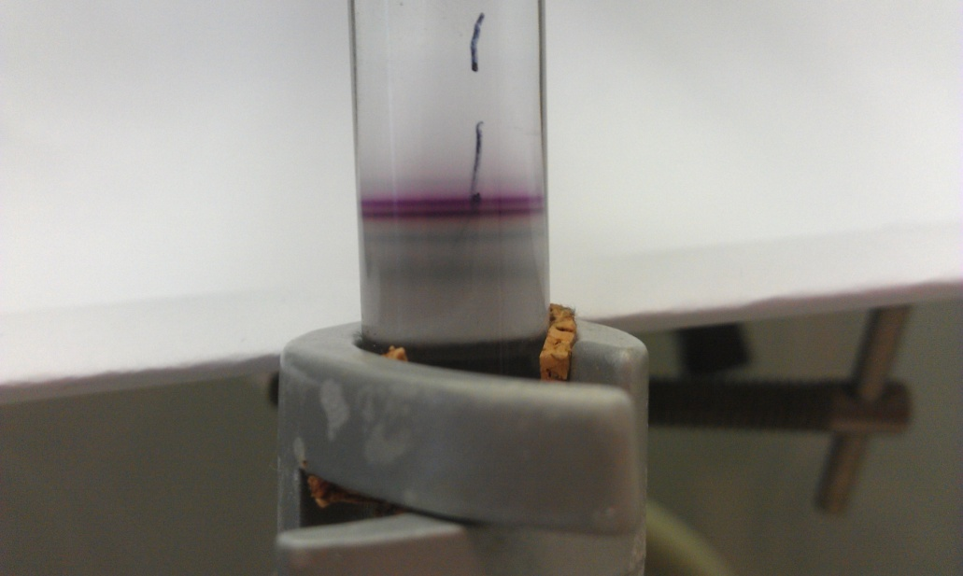

Circular Dichroism spectra
Group | Method | CDraw(mdeg) | L CD(cm) | AE22 | Labs (cm) | Cdnorm (mdeg) | ee(%)
Weisman | DGU | 20 | 1.0 | 0.55 | 1.0 | 36 | 100
Hersam | DGU | 13 | 1.0 | 0.60 | 1.0 | 22 | 61
Komatsu | Molecular recognition | 4.0 | 10 | 0.017 | 1.0 | 24 | 67
Lower layer | DGU | 16 | 1.0 | 0.51 | 1.0 | 31 | 87
Upper layer | DGU | 24.5 | 1.0 | 0.70 | 1.0 | 35 | 97

Slide 9
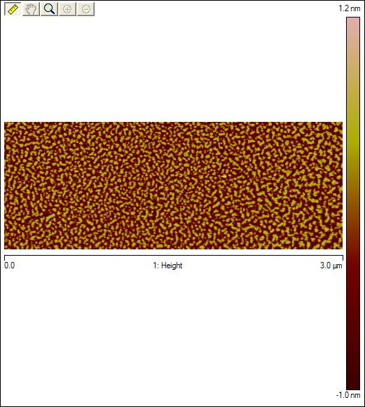
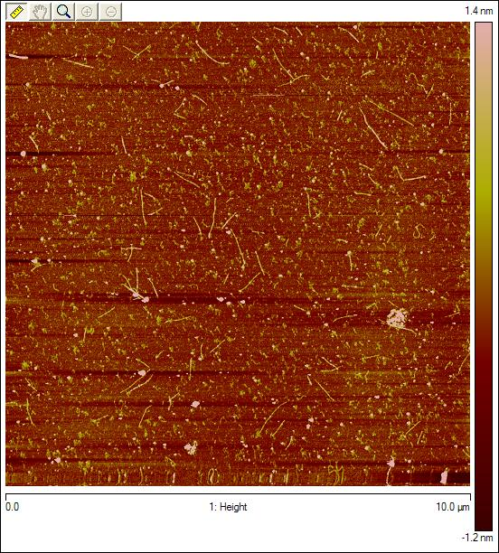
Post-treatment of sorted swnt fractions
DIALYSIS - to remove the gradient and most of the free chiral sodium cholate
Absorption spectra also show a red shift of 5 nm (data not shown)

Slide 10
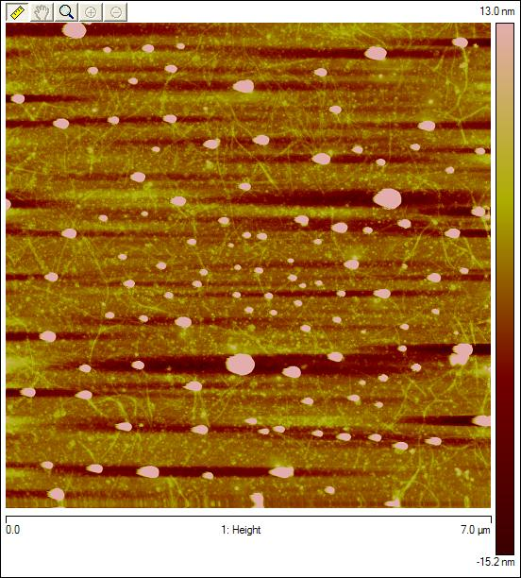
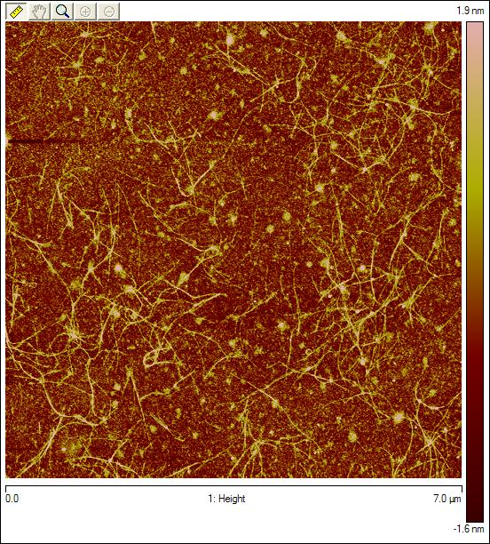
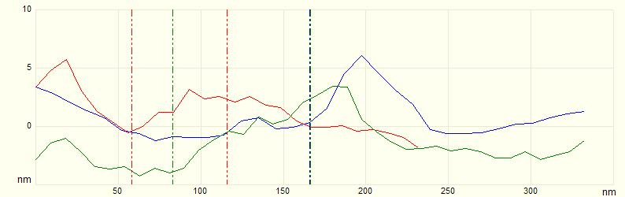
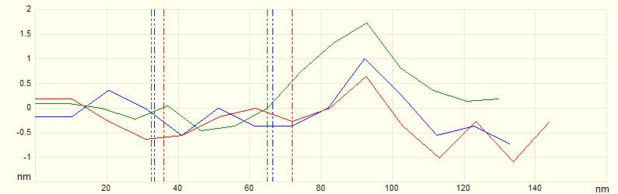
ANNEALING-The dropcasted SWNT-FET device is annealed at 500 ⁰ C for 12h to remove the free and wrapped surfactant
Before Annealing
After Annealing

Slide 11
NIR Fluorescence Measurements of SWNTs upon Amino acid addition

Slide 12
Reason for NIR Fluorescence
one-dimensional direct electronic band gap
A narrow excitation peak in the visible region (500-600 nm) produces an intense fluorescence in the NIR region
the short lifetime eliminates non-radiative deactivation and thus gives SWNTs high fluorescence quantum yields

Slide 13
Towards Histidine
Chiral (6,5) SWCNT
Achiral (6,5) SWCNT

Slide 14
Towards Lysine
Chiral (6,5) SWCNT
Achiral (6,5) SWCNT

Slide 15
SWNT-FET Device
Motivation
To lower the detection limit of aminoacid and also the amount of nanotubes

Slide 16
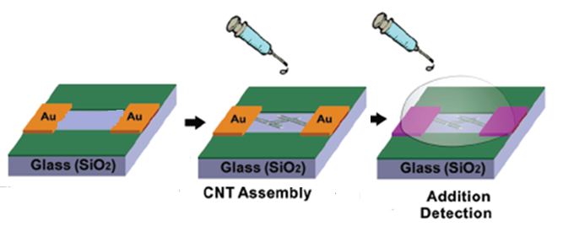
DEVICE FABRICATION

Slide 17
Confirmation of Network of SWNT by AFM
AFM image of dropcasted dialysed racemic (6,5) SWNT

Slide 18
Transfer Characteristics of Transistor
Gate dependence of source-drain current
Semiconductor behavior of CNT -- On/Off ratio

Slide 19
Factors optimized for improved SWNT-FET device performance
Thickness of CNT network on the device channel
Amount of CNT solution added | On/Off Ratio
0.5 microlitres | 1 x 10⁴
2.0 microlitres | 5 x 10¹

Slide 20
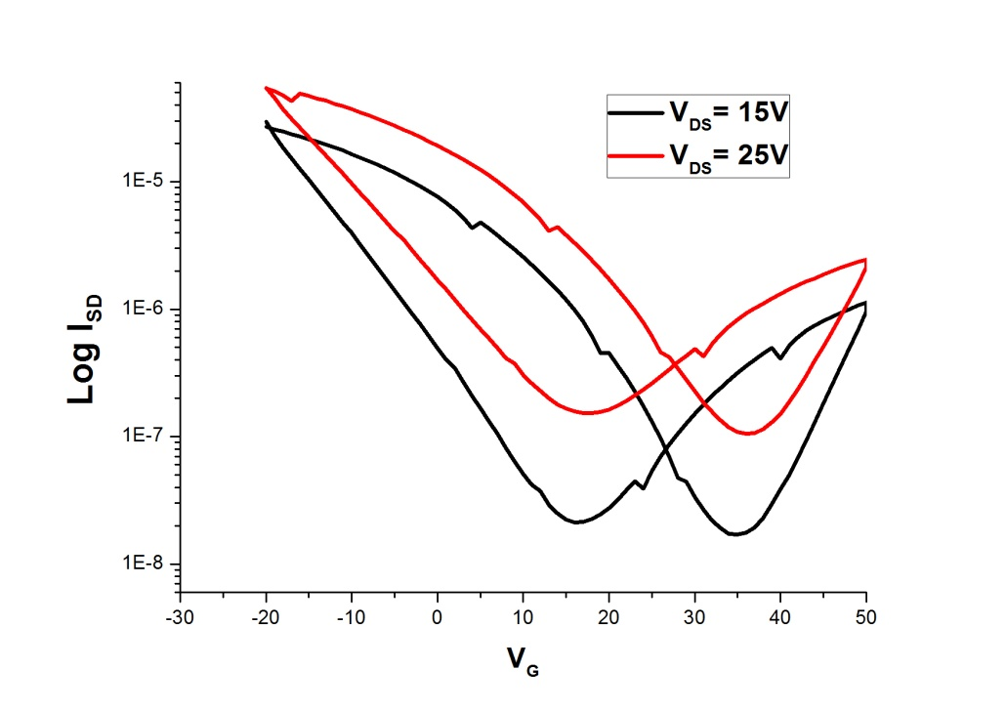
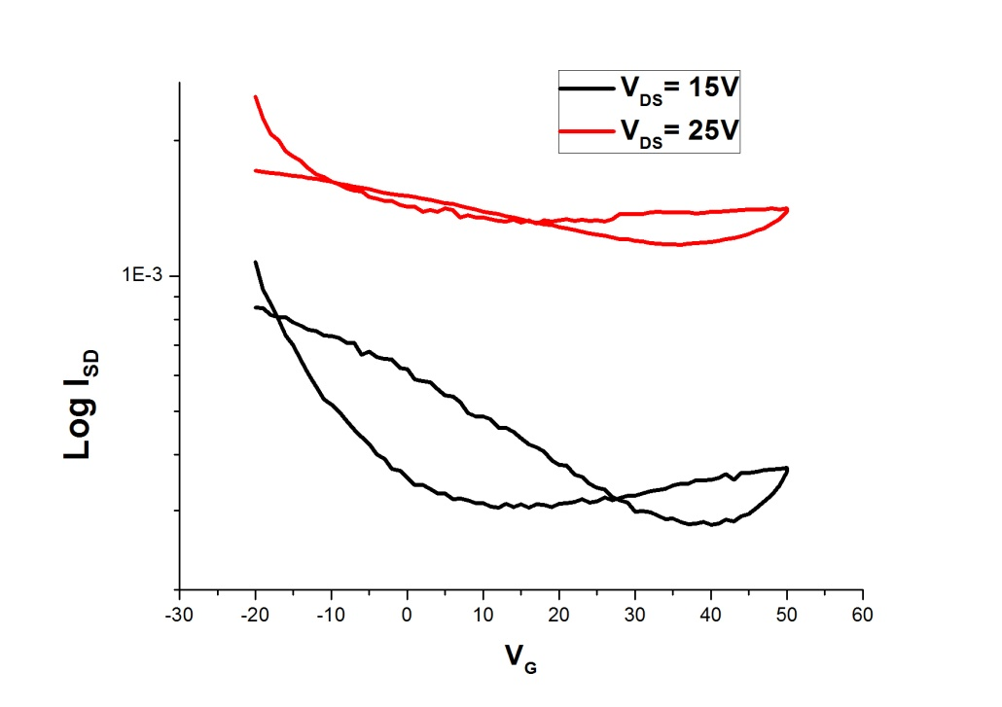
2. Channel width
Width of the device channel | On/Off ratio
20 micrometres | 1.4 x 10³
2.5 micrometres | 3
20 micrometres
2.5 micrometres

Slide 21
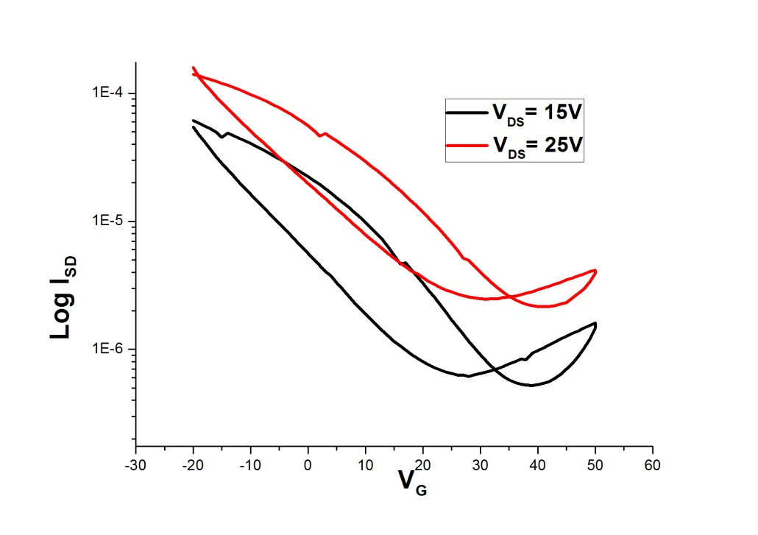
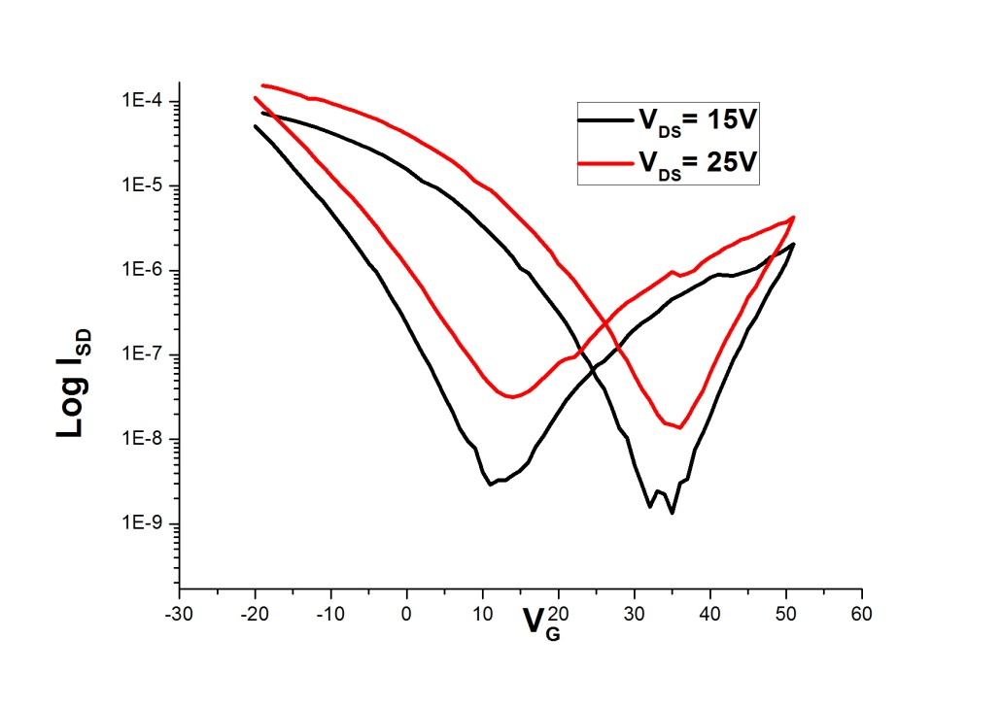
3. Surfactant concentration
Type of CNT | On/Off ratio
Undialysed | 0.7 x 10²
Dialysed | 1 x 10⁴
Before dialysis
After dialysis

Slide 22
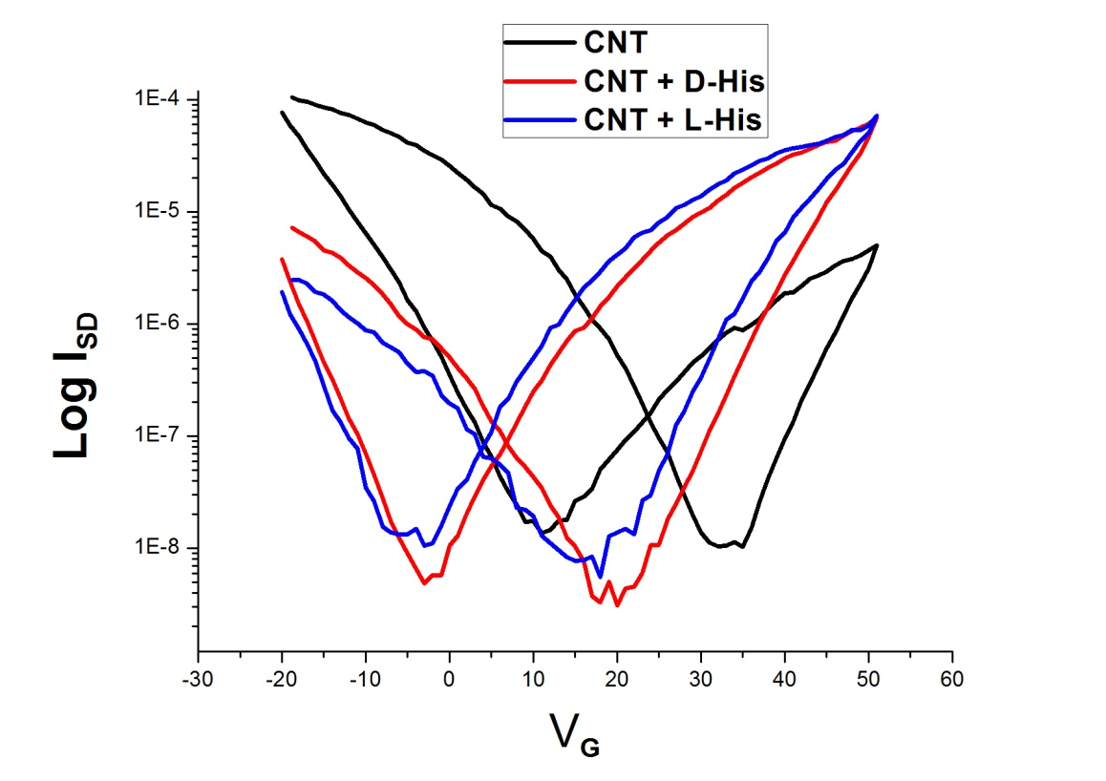
Preliminary results of SWNT-FET with Aminoacid
Solution Used for Dropcasting | Current On/Off ratio
Racemic dialysed (6,5) SWNT | 1.0 x 10⁴
Racemic dialysed (6,5) SWNT with D-Histidine | 0.7 x 10⁴
Racemic dialysed (6,5) SWNT with L-Histidine | 1.4 x 10⁴
V_{SD}= 25 V

Slide 23
Summary
Optimization of the non-linear DGU to obtain both enantiomers of (6,5) SWNT
Investigation of various parameters that affect SWNT-FET device performance

Slide 24
Acknowledgements
Prof. Dr. Andreas Herrmann
Lifei Zheng
Eric de vries
Vladimir (Dr. Loi’s group)
& all the polymer chemistry group members
THANK YOU

